Slide 1
Summative Capstone
Sales Prediction

Slide 2
Business Objective
Objective
Build a machine learning model to predict the sales of a few supermarket chains
Business Questions to be answered with prediction
What are the predicted sales of the
individual grocery outlets ?
categories of products ?
individual products ?
food products based on fat content?
grocery outlets based on location, size and type of outlet ?

Slide 3
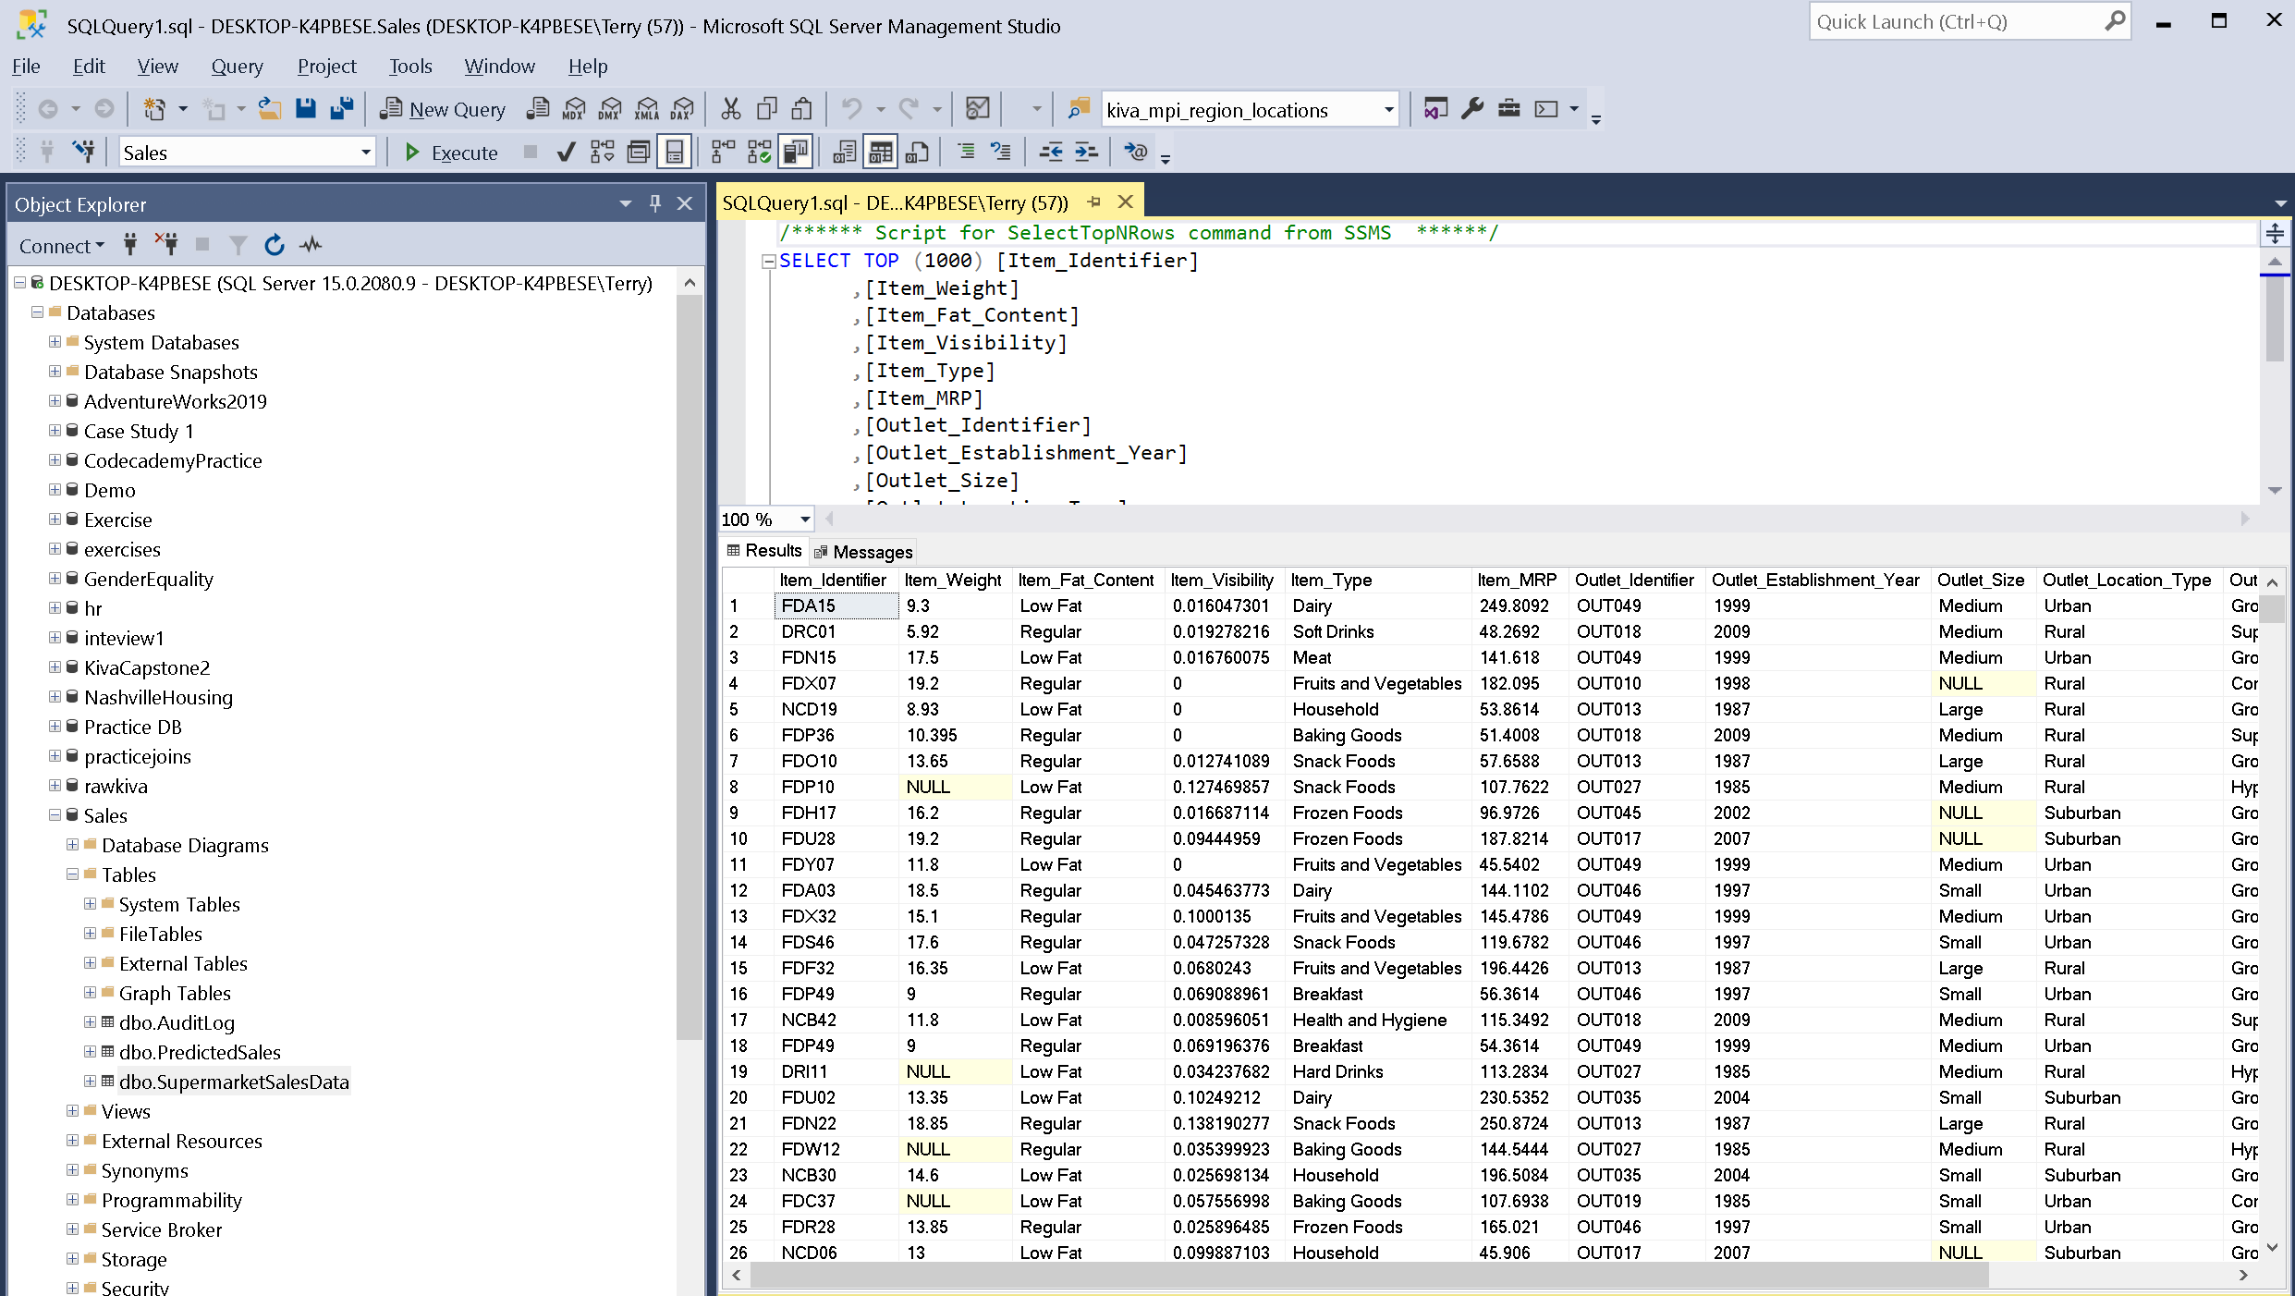
Data in MS SQL Server

Slide 4
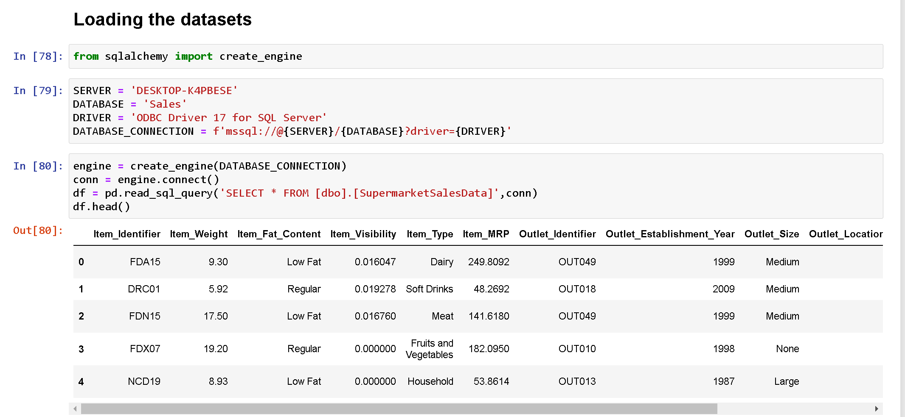
Getting Data from SQL Server to Dataframe

Slide 5
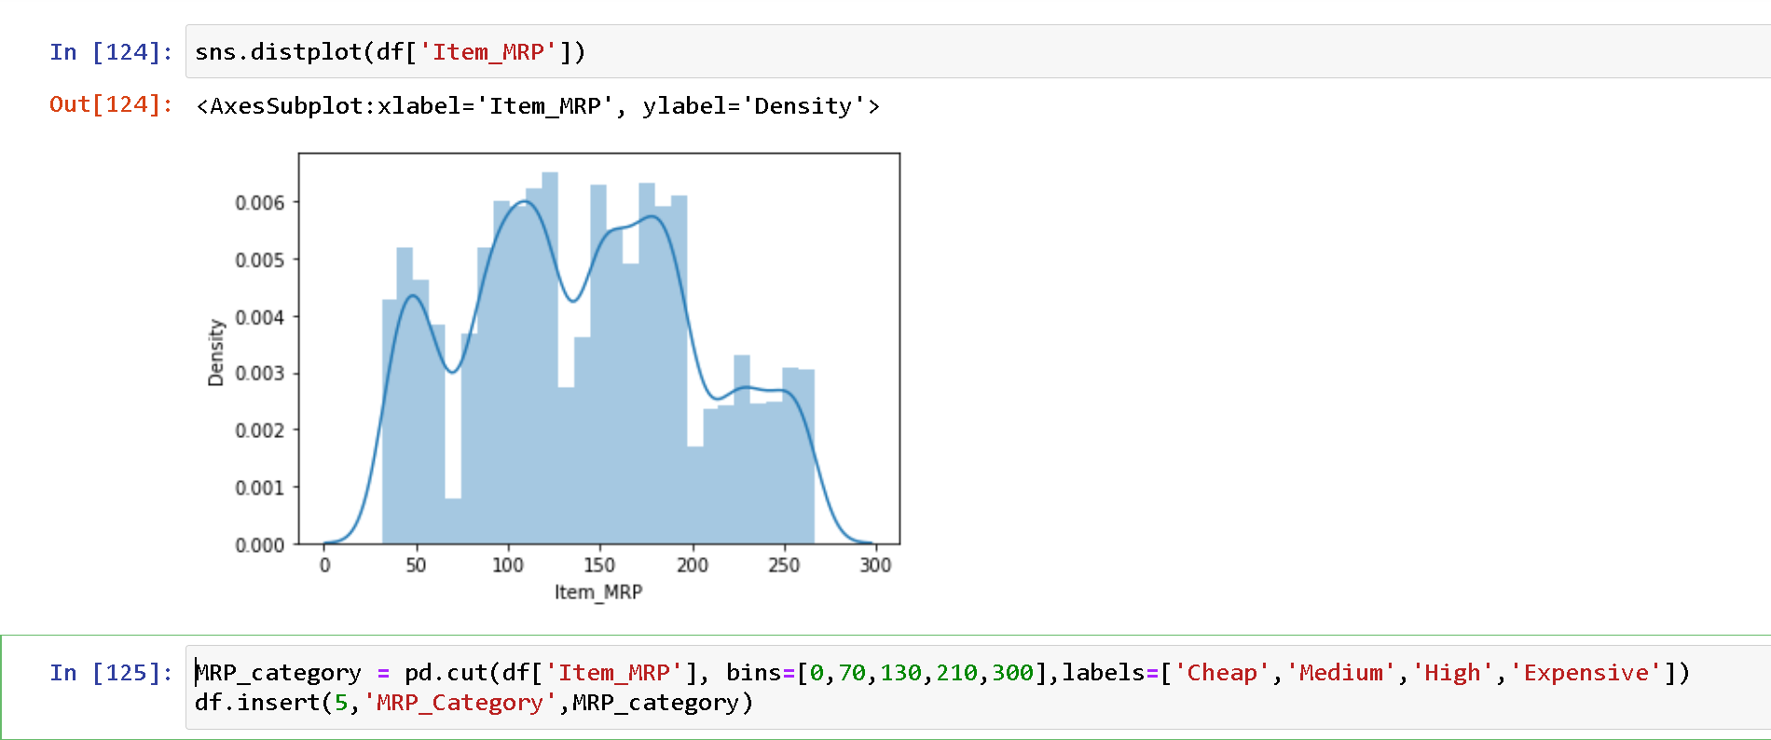
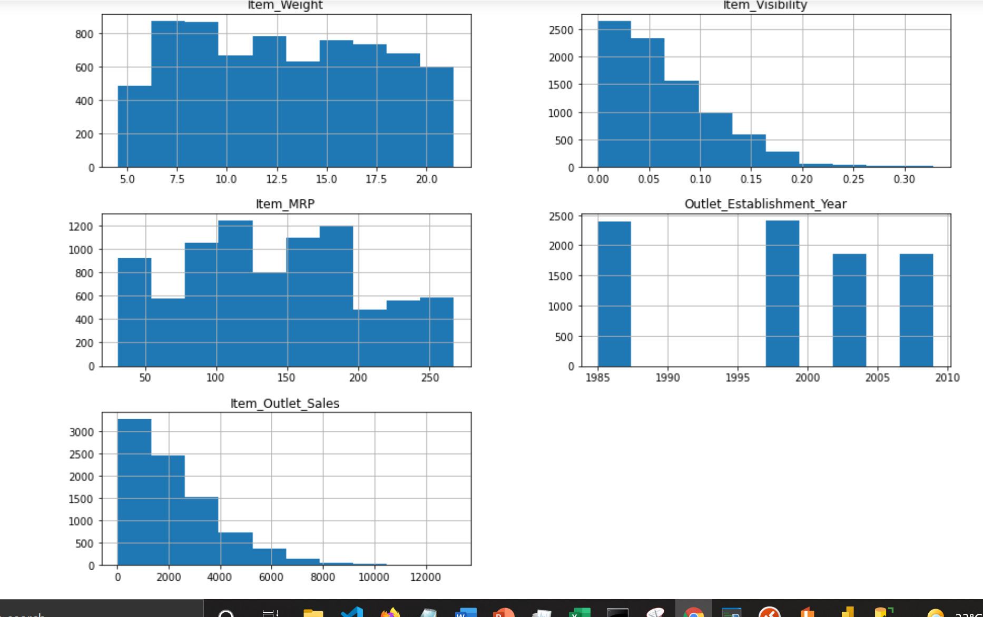
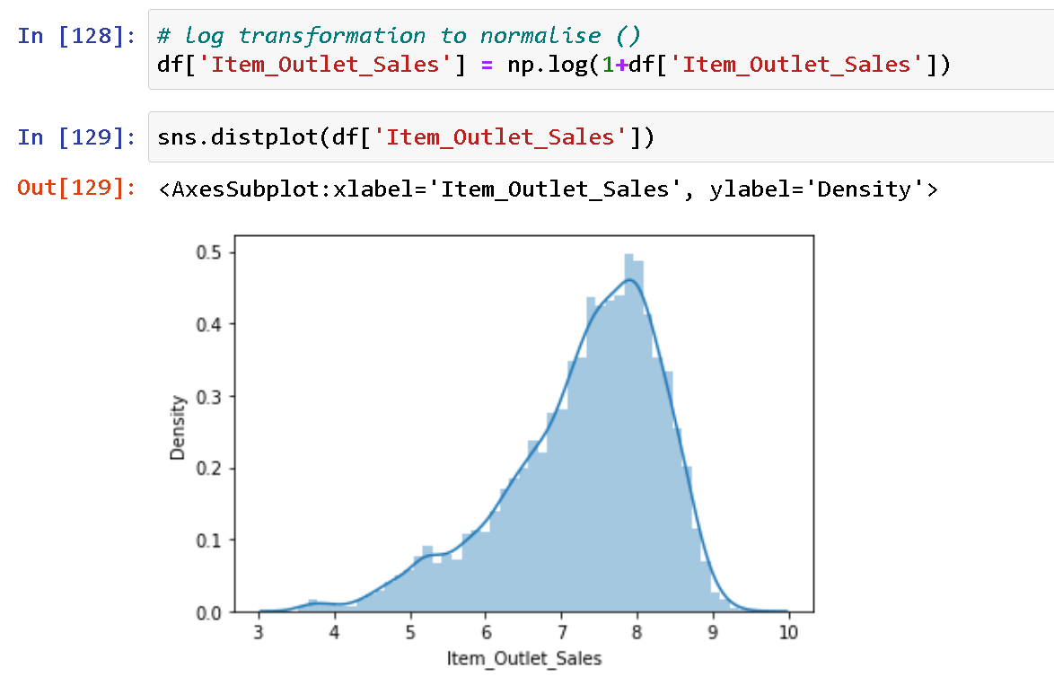
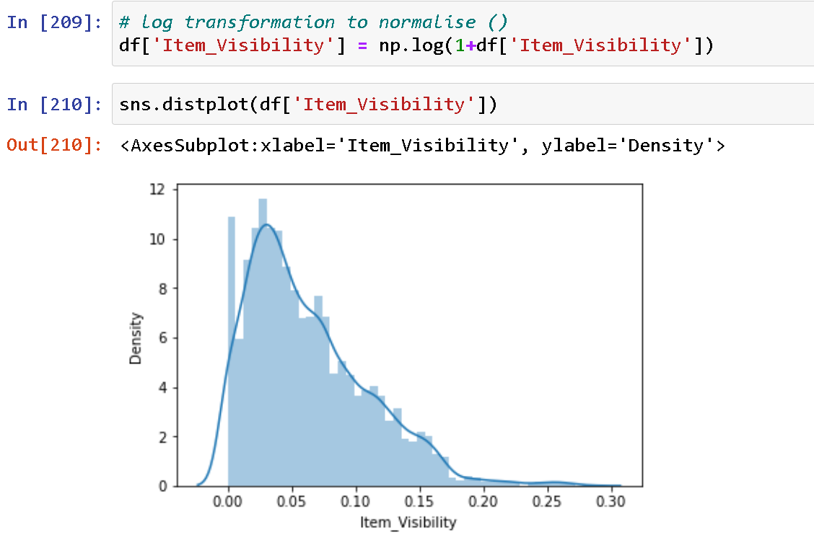
Understanding the Data (Continuous Features)

Slide 6
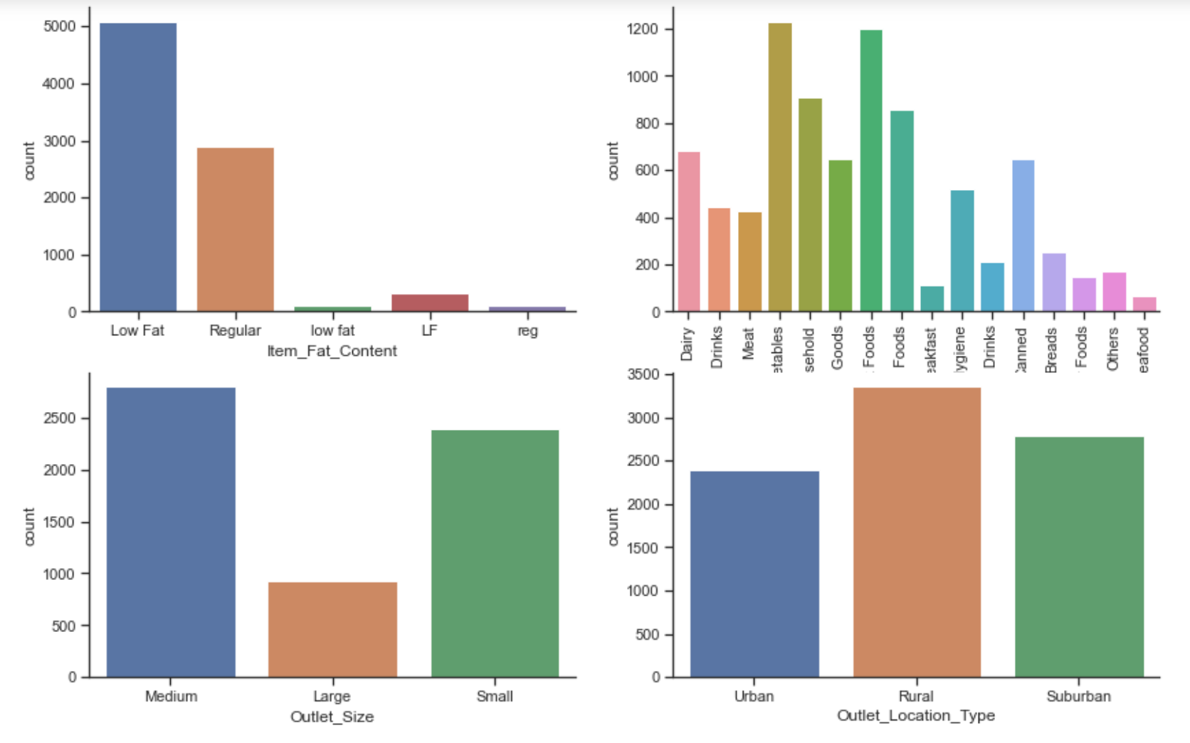
Understanding the Data (Categorical Features)

Slide 7
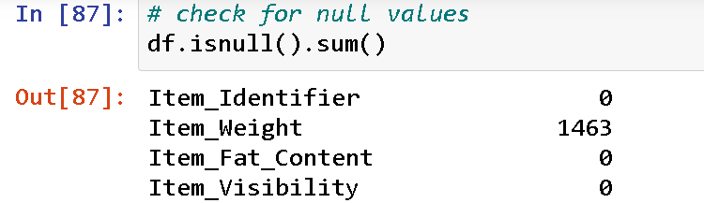
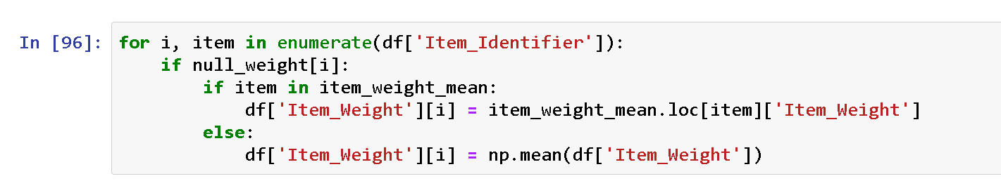
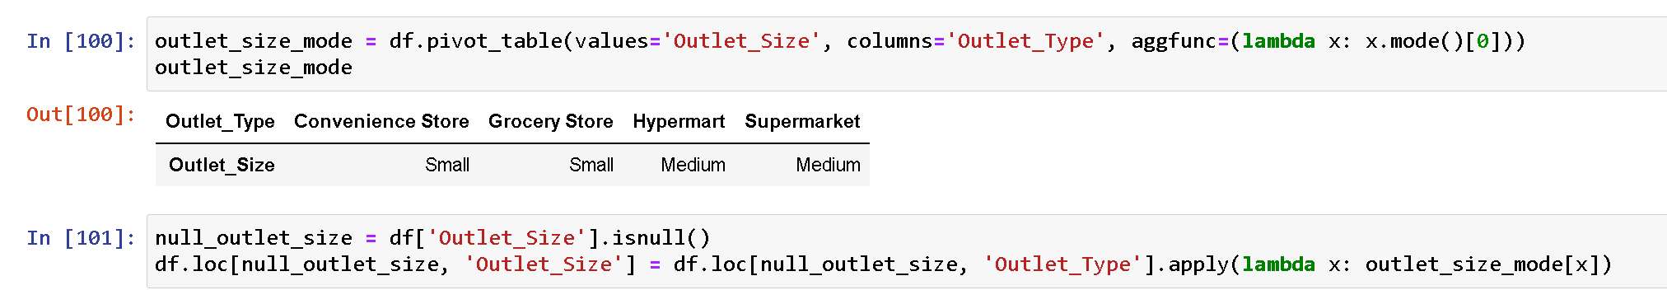
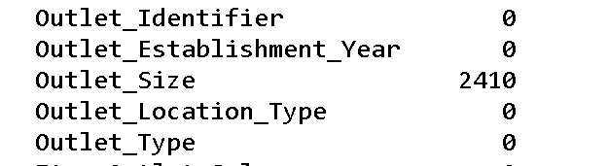
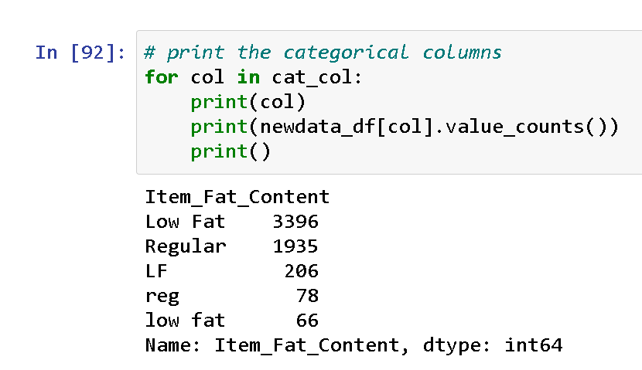
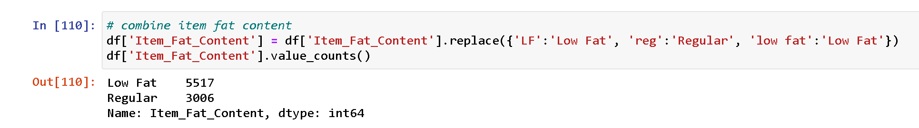
Data Cleaning
Imputing Missing item weight with different means
Imputing Outlet Size
Consolidating fat content for food items

Slide 8

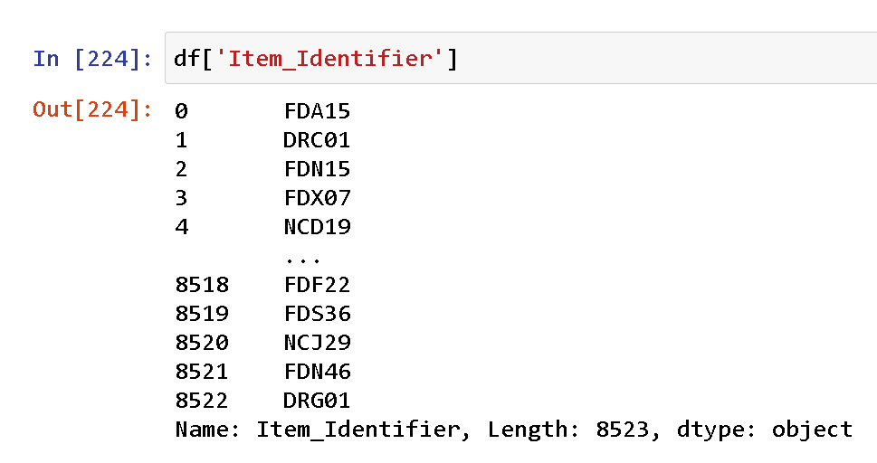
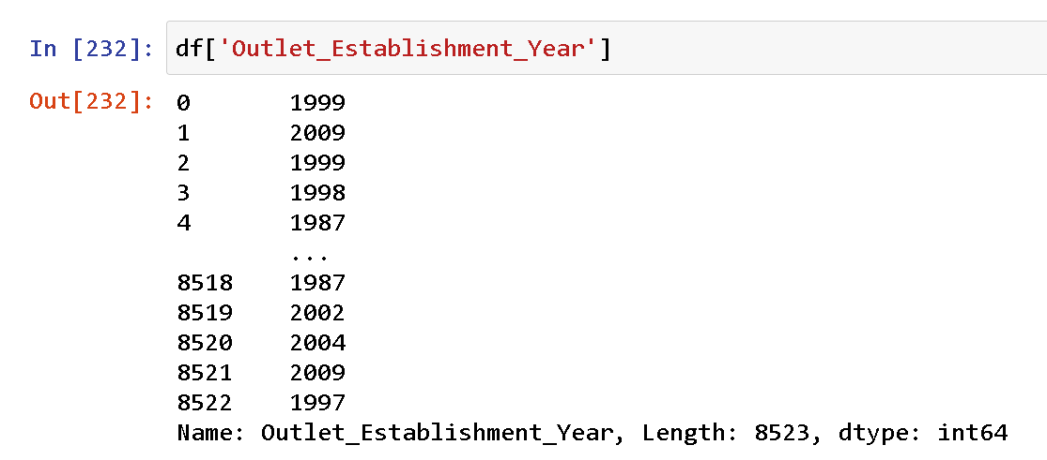
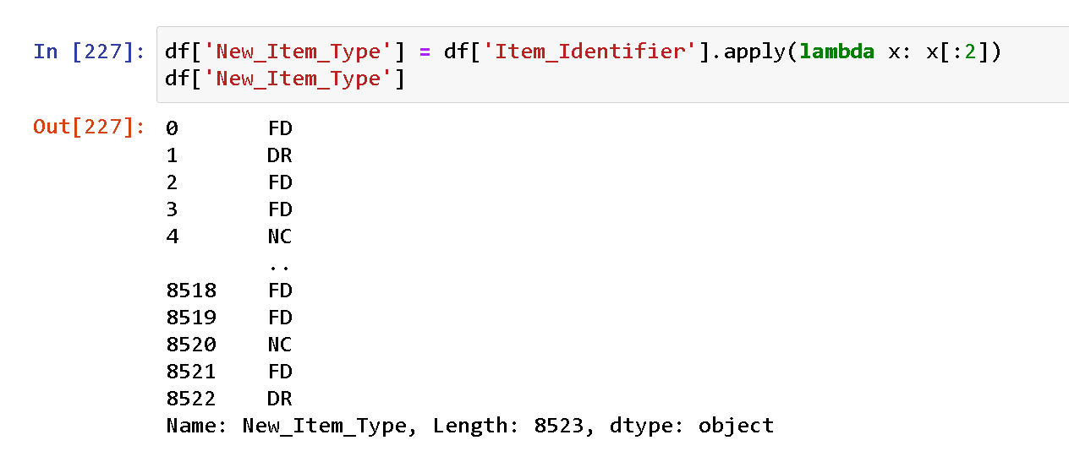
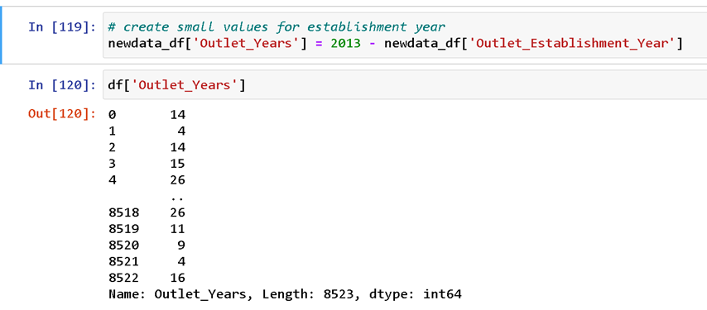
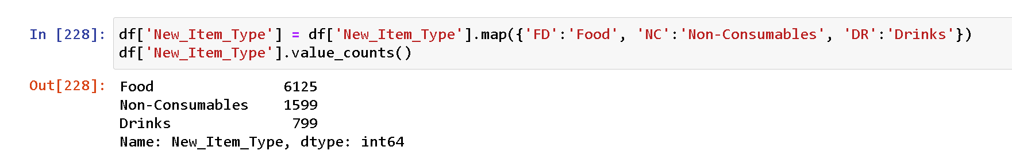
Data Preprocessing and Feature Engineering
1. Creating a new feature containing the Main Categories of Products Sold from Item Identifier
2. Reducing values of outlet establishment year to smaller values

Slide 9
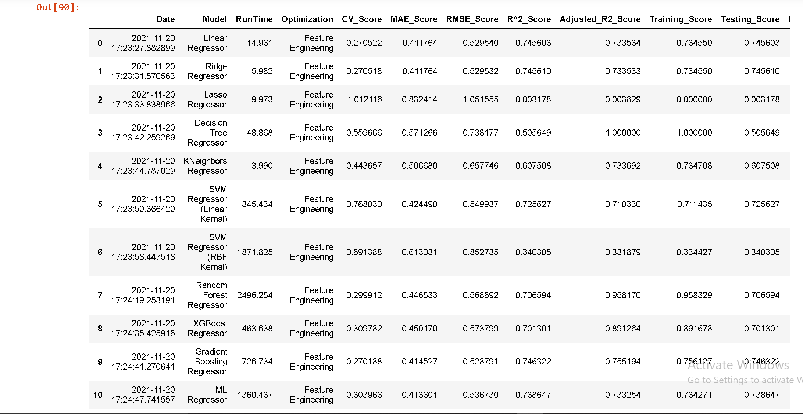
Preliminary Model Training Scores
Resolve overfitting issue by feature selection, PCA and Hyperparameter Tuning

Slide 10
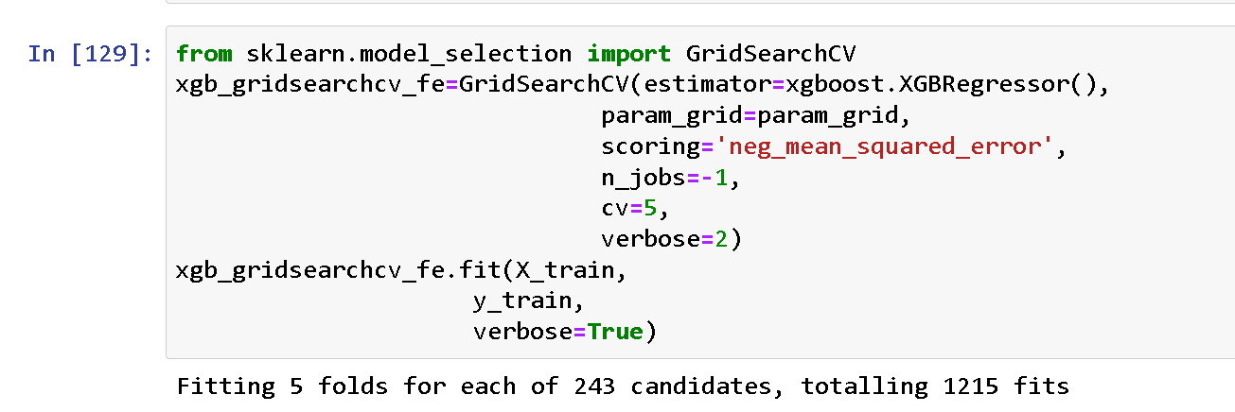
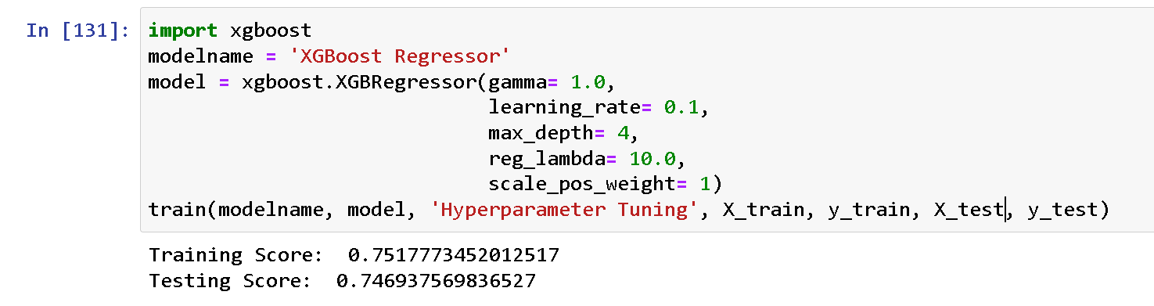
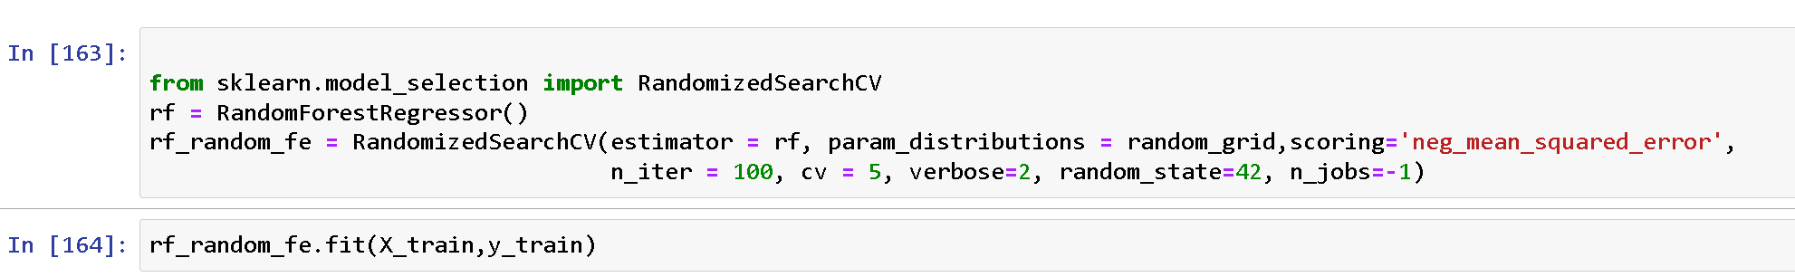
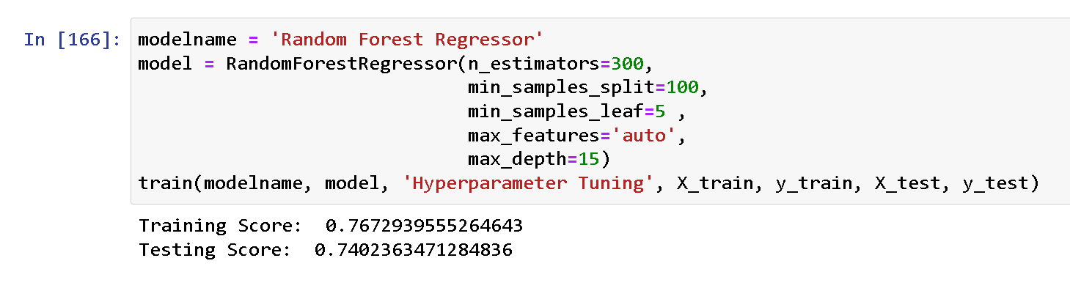
Hyperparameter Tuning of Random Forest Regressor and XGBoost Regressor

Slide 11
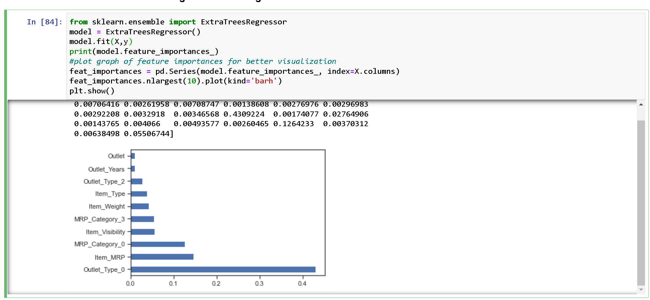
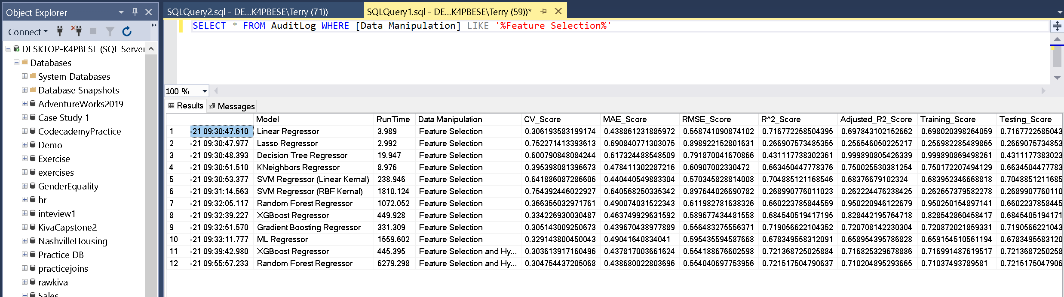
Feature Selection using ExtraTreesRegressor

Slide 12
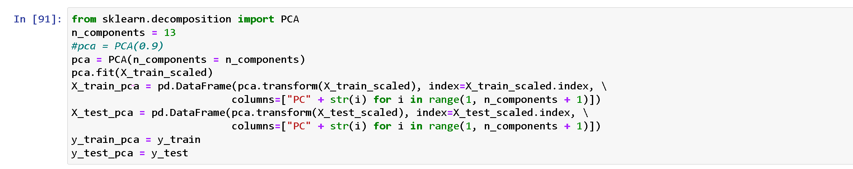
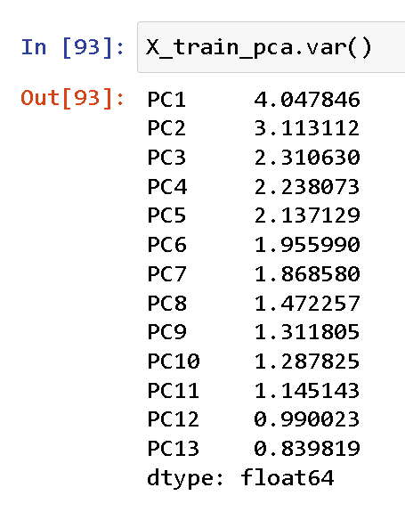
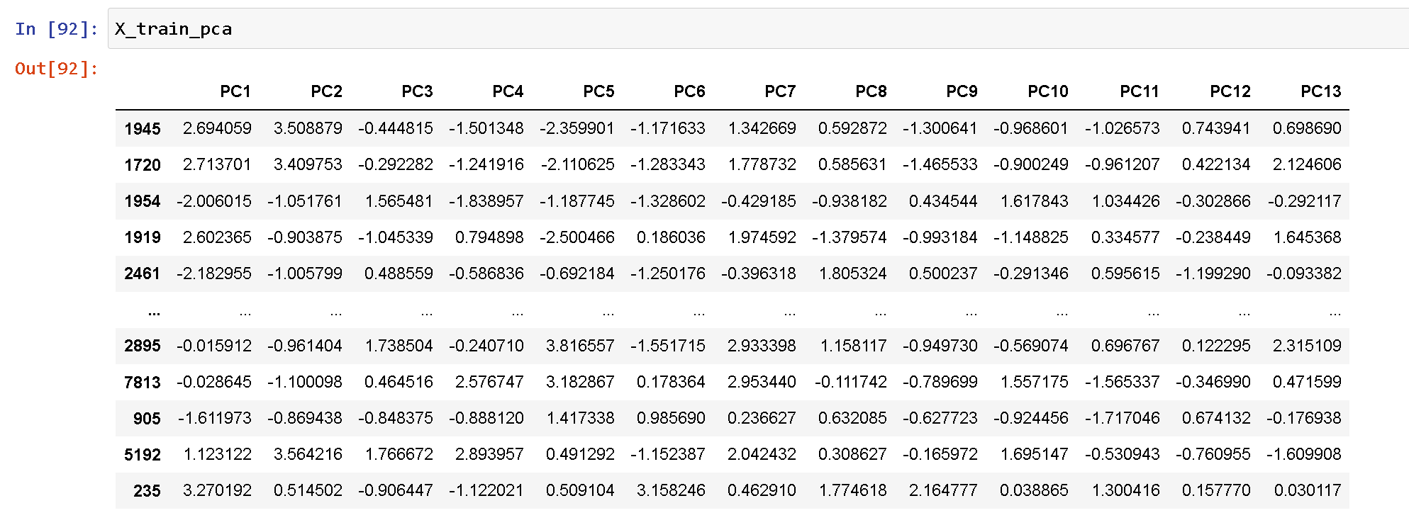
Resolving Model Overfitting with Principal Component Analysis

Slide 13
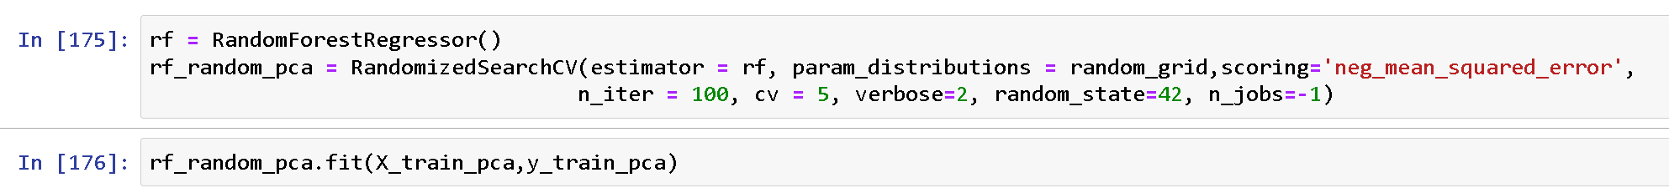
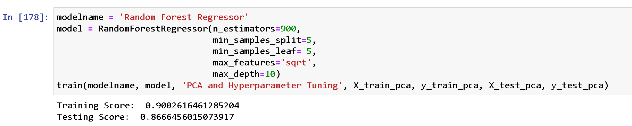
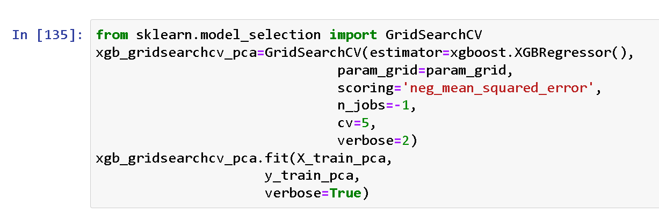
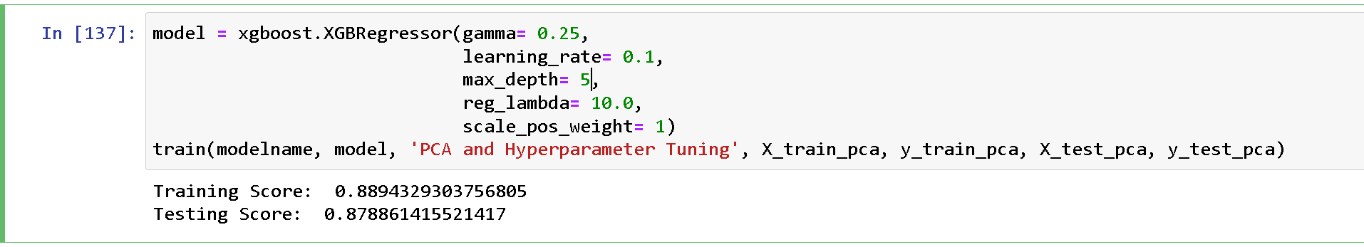
Results after Principal Component Analysis and Hyperparameter Tuning

Slide 14
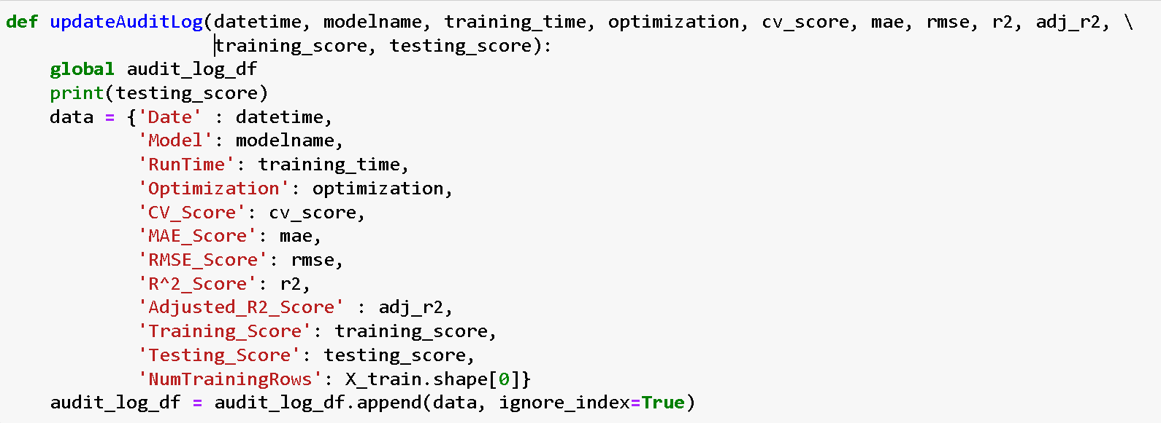
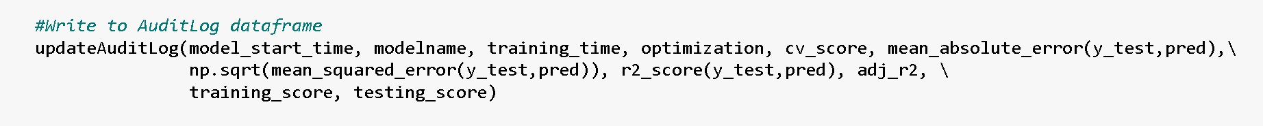
Exporting the Audit Log of Model Training to SQL Server

Slide 15
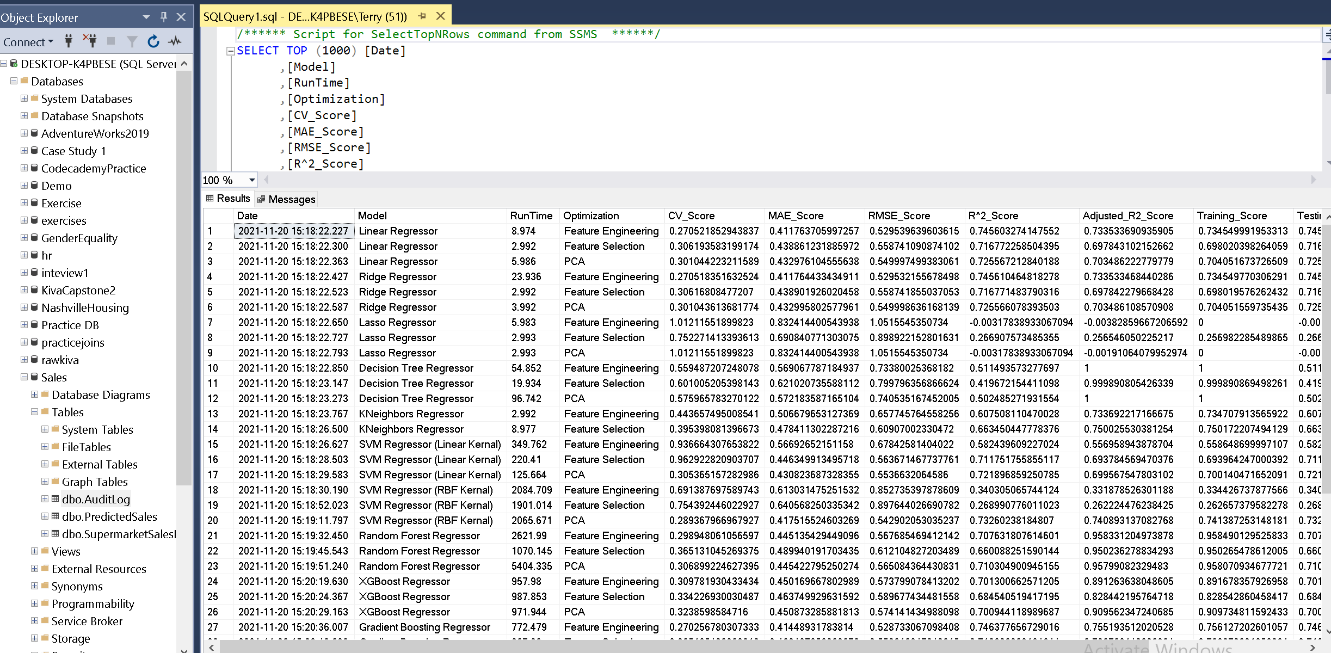
Scores of Regression Models

Slide 16
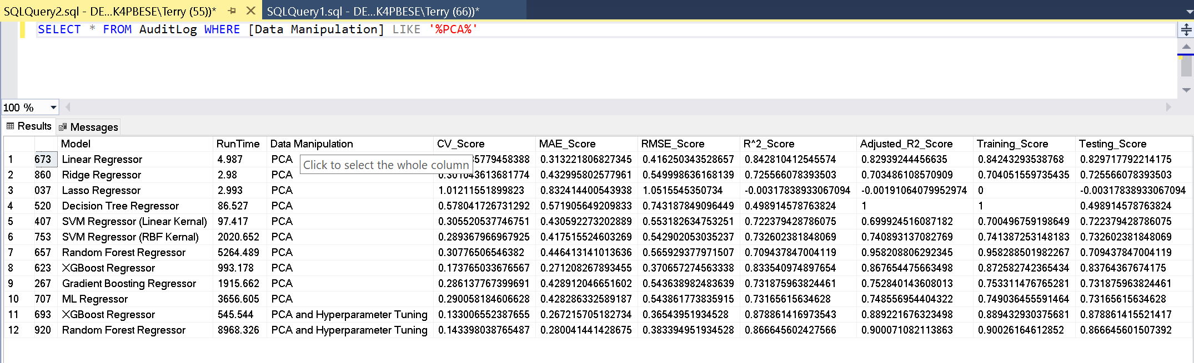
Principal Component Analysis and Hyperparameter Tuning

Slide 17
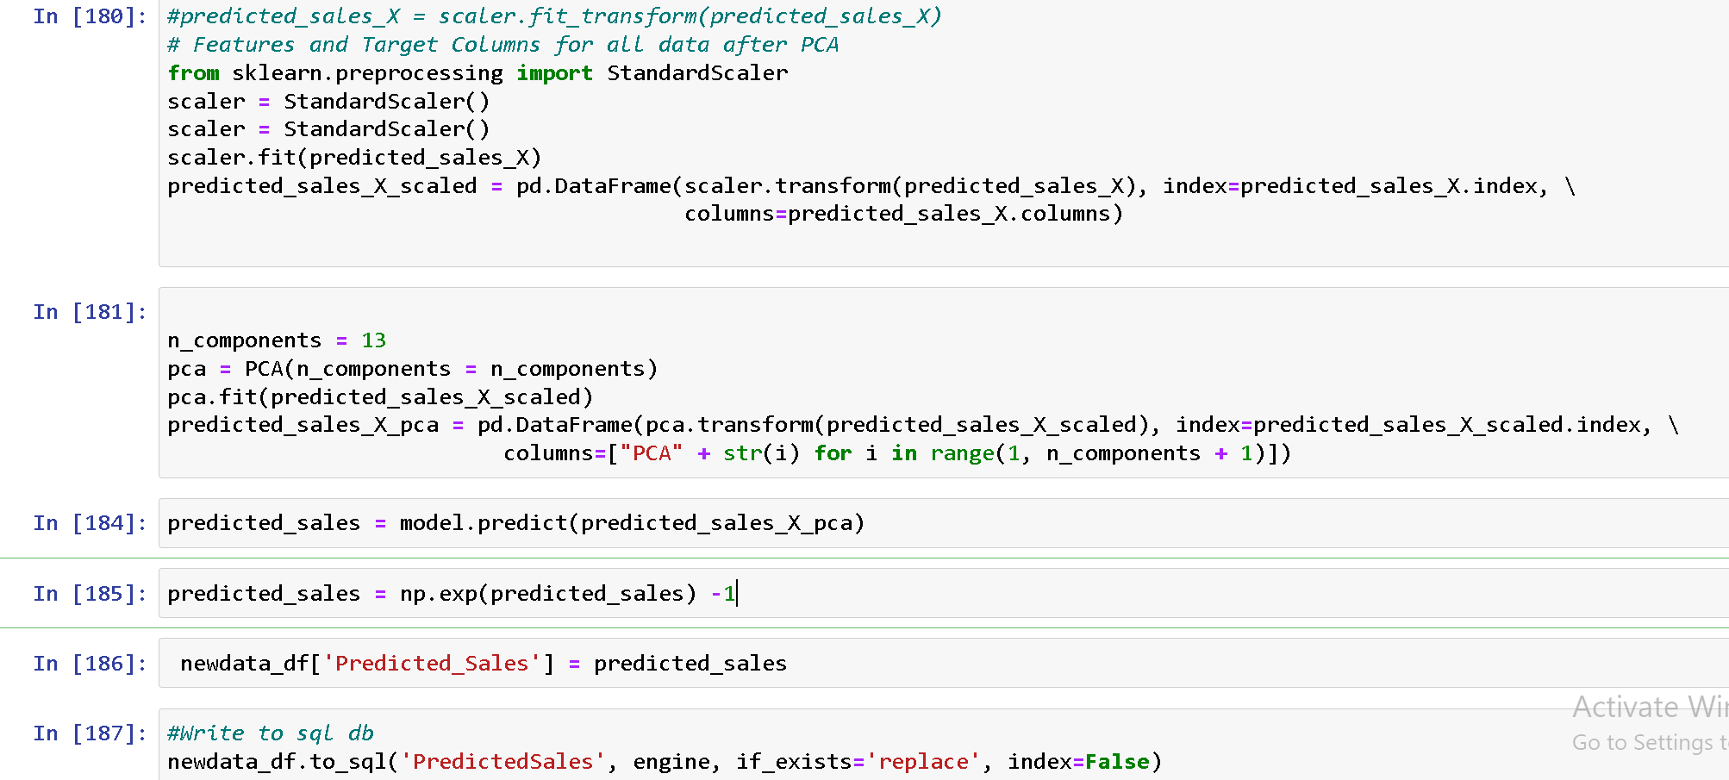
Predicting the sales with chosen Model (XGBoost Regressor)

Slide 18
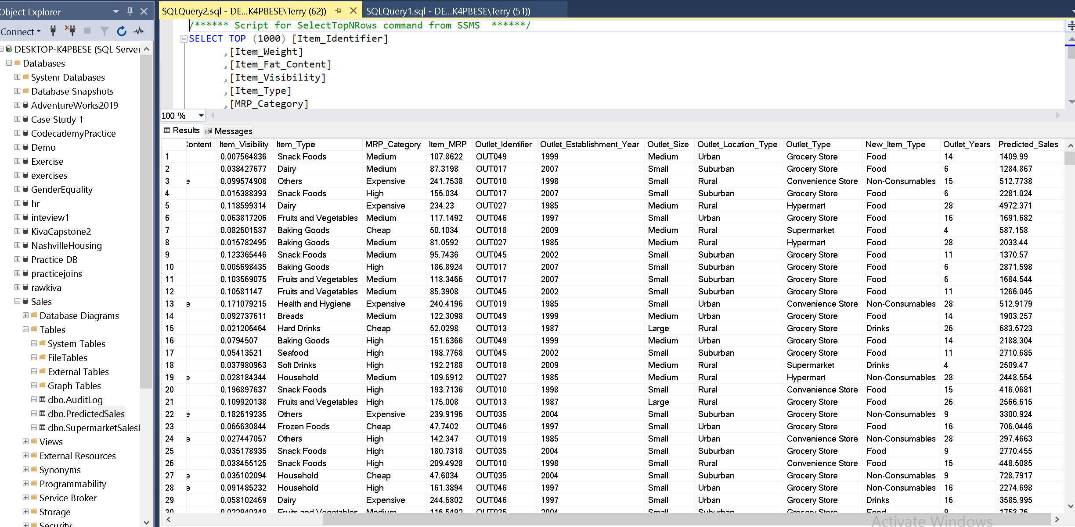
Exporting Sales Prediction to SQL Server

Slide 19
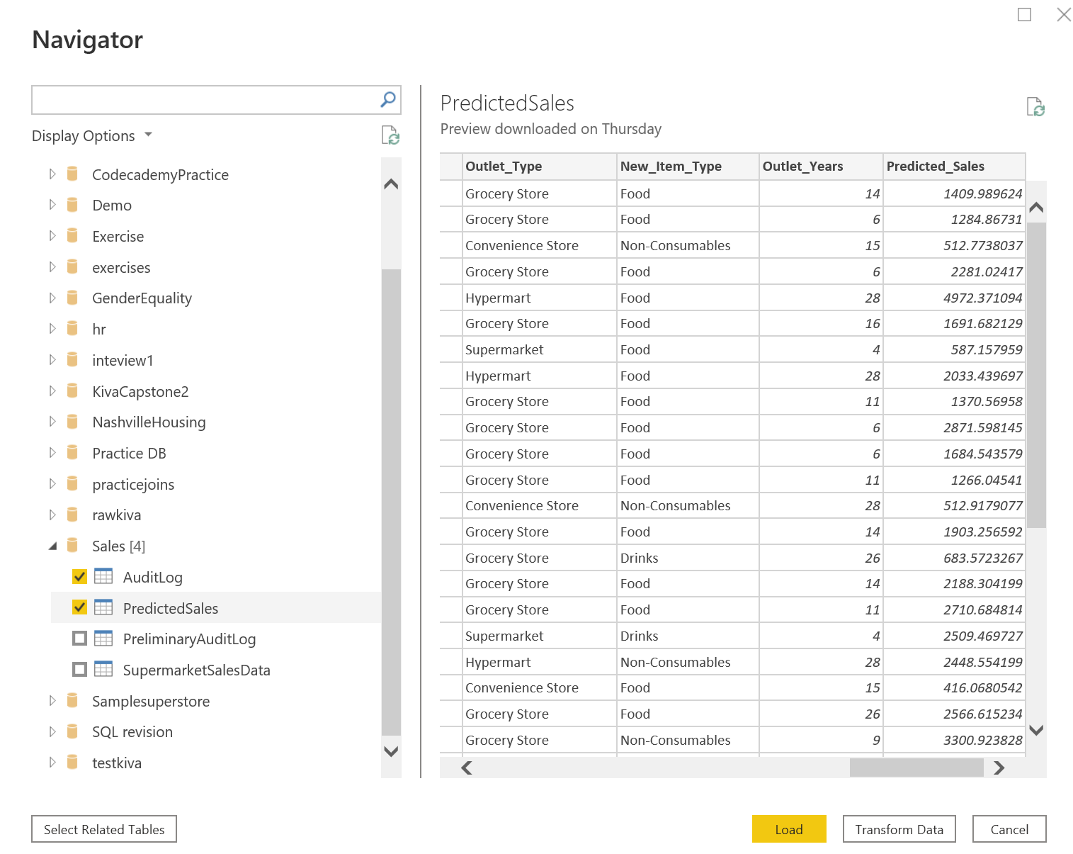
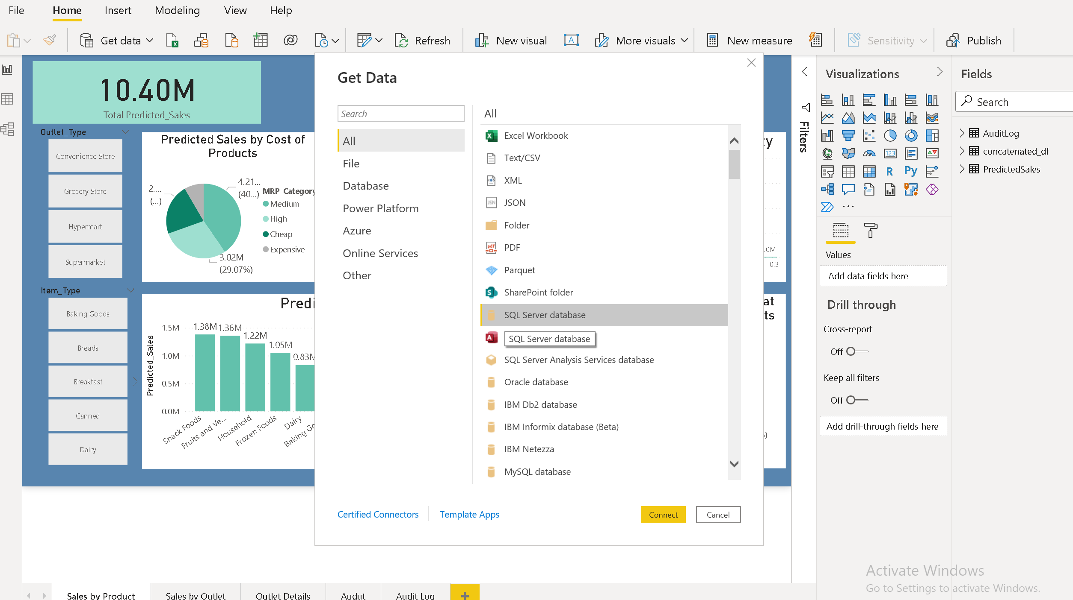
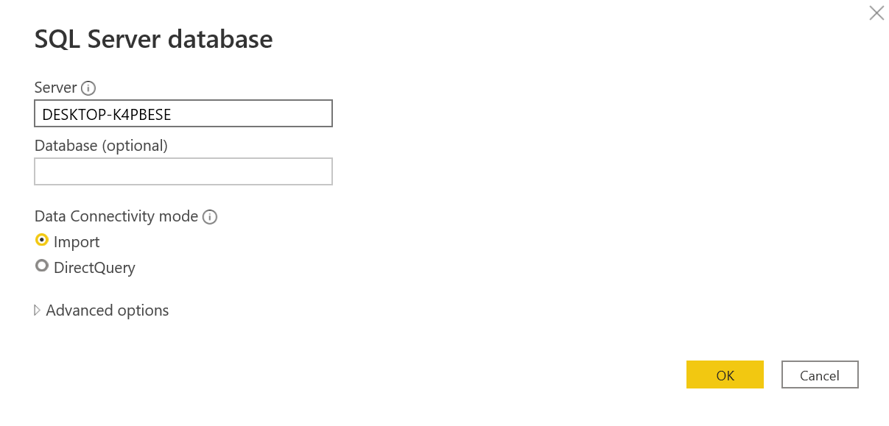
Getting Predicted Sales Data and AuditLog Data from SQL Server to Power BI

Slide 20
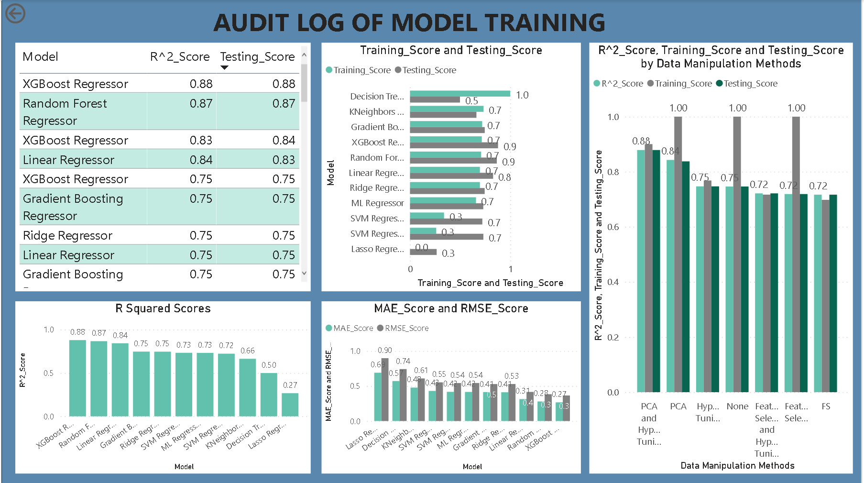
Power BI Visualisation of AuditLog

Slide 21
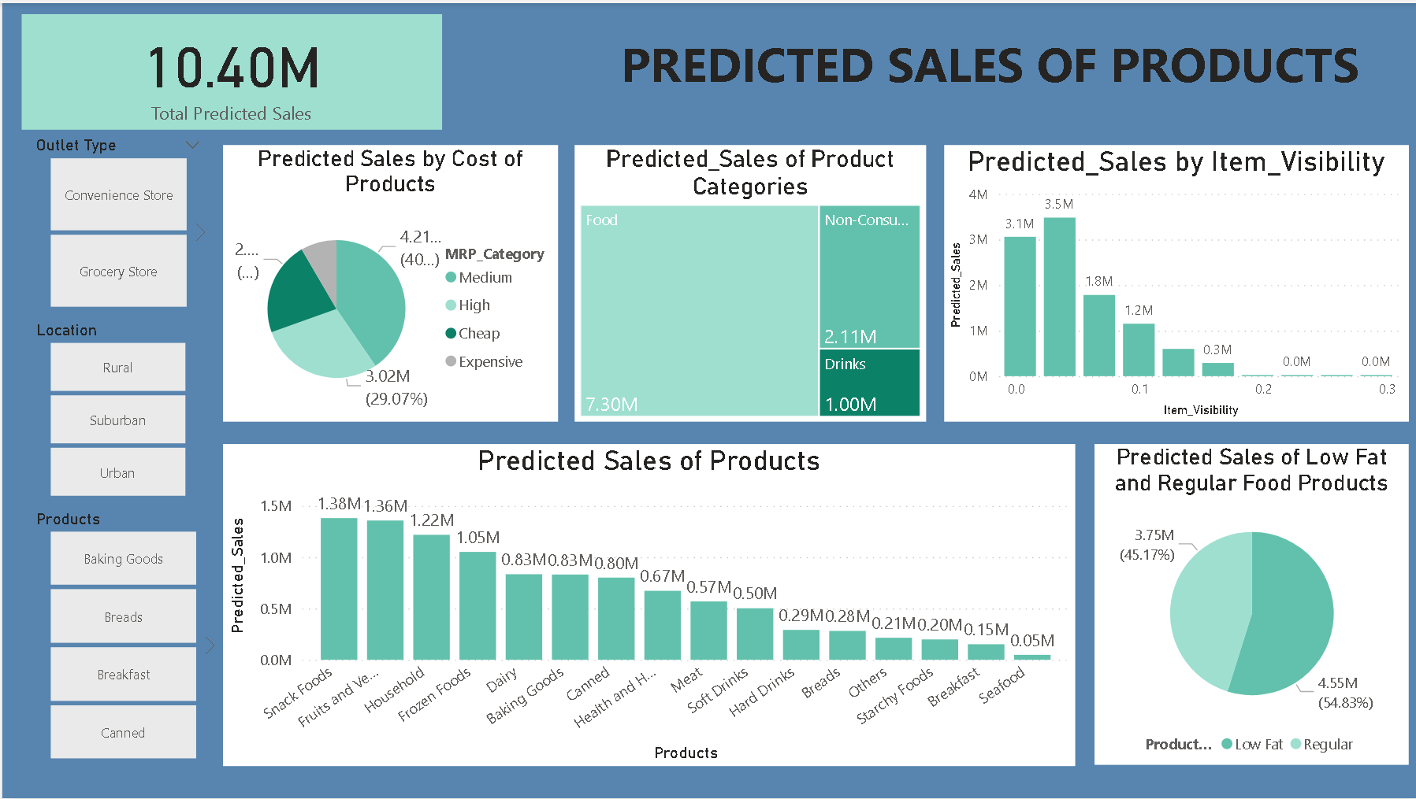
Insights from Predicted Sales (Products)
Item visibility does increase sales (smaller vales indicate higher visibility)
Low Fat foods do sell more than foods with regular fat content
Food items generate the most sales followed by non consumables
Medium MRP (Mariginal Revenue Product) items sell the most
Top 3 performing products are snack foods, fruits and vegetables and household products

Slide 22
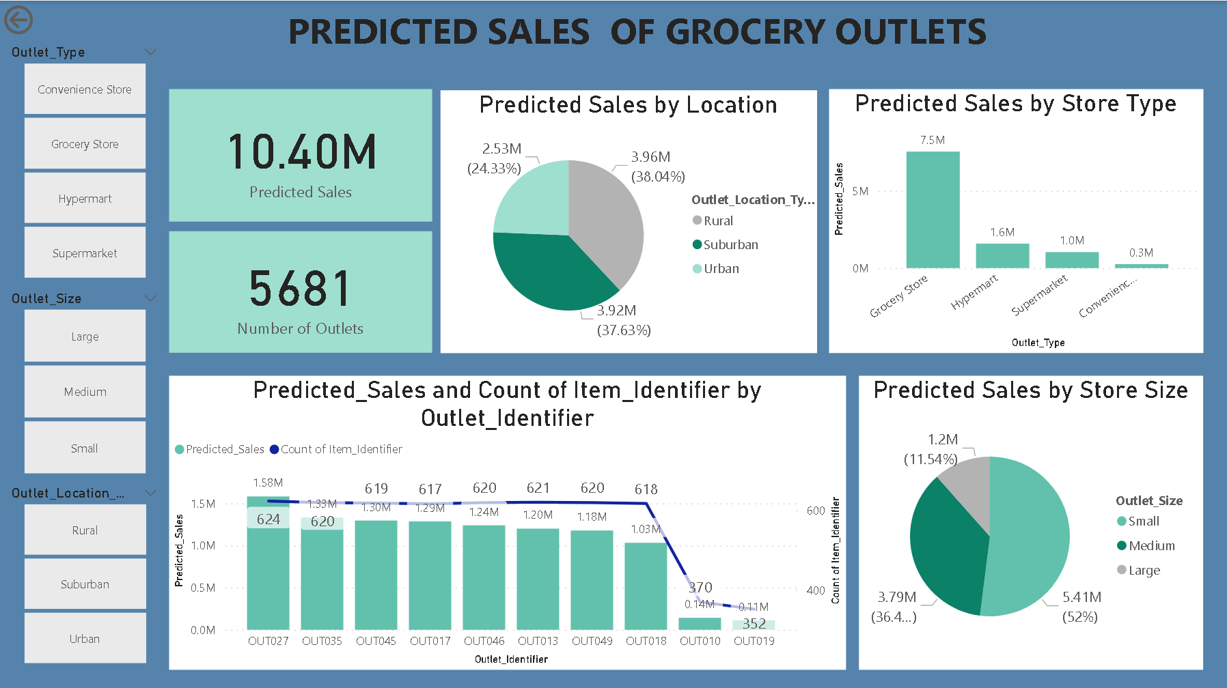
Insights from Predicted Sales (Location)
Outlets in the rural area are predicted to generate the most sales (41%)
Grocery Stores will generate the most sales significantly more than hypermarts, supermarkets and convenience stores
Small grocery stores are predicted to generate the most sales
Top 3 performing outlets are OUT027, OUT046 and OUT045

Slide 23
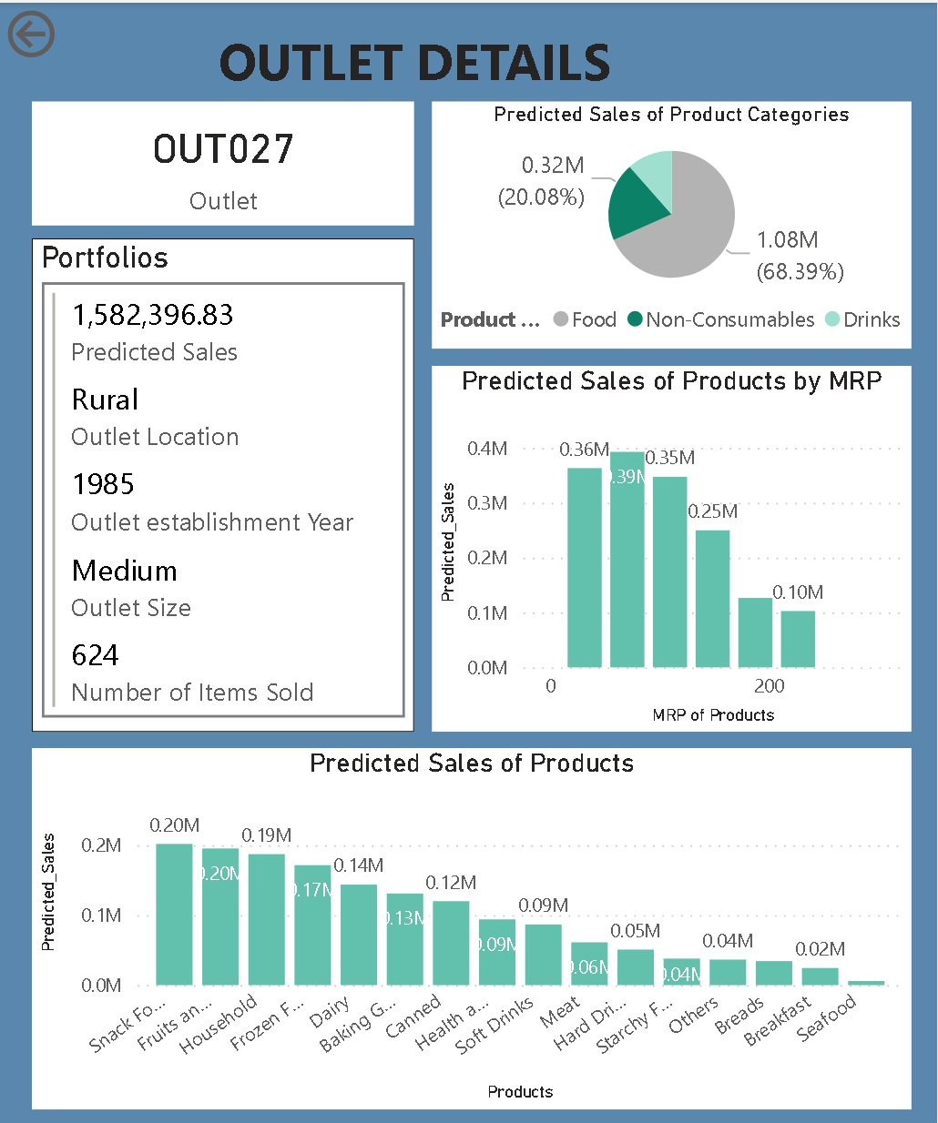
Insights from Predicted Sales (Outlet)
Predicted sales of individual outlet
The type of location the outlet is at
Size of outlet
The predicted sales of product categories that the outlet sells
The predicted sales of the individual products of the outlet
The number of products that outlet sells

Slide 24
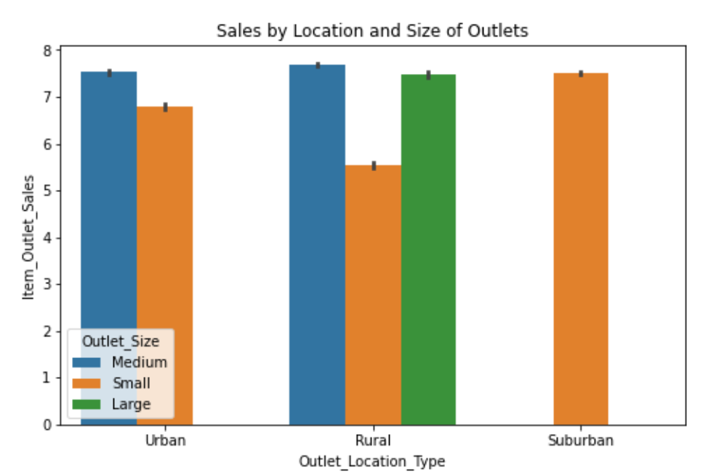
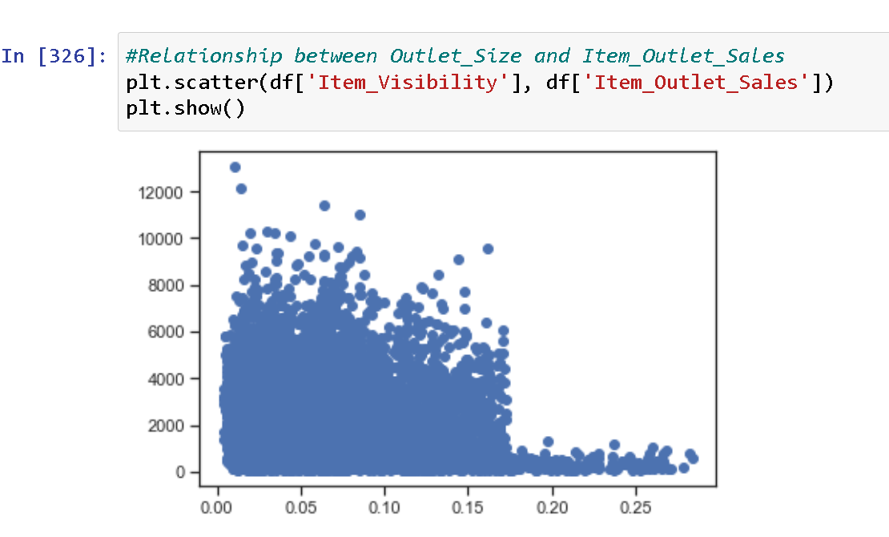
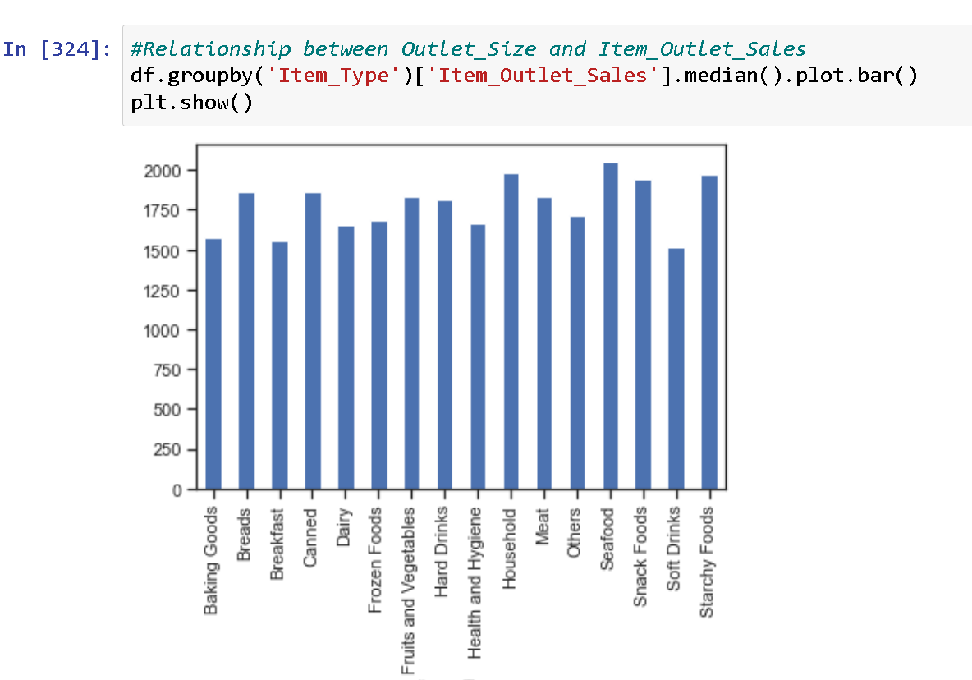
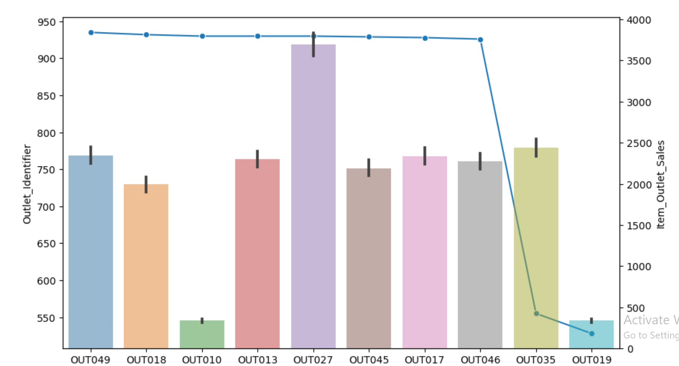
Recommendations by Comparison with Historical Sales Data
Historical sales show that medium sized and larger outlets generate the most sales in rural areas and smaller outlets generate the most sales in suburban and urban locations
Item Visibility should be kept < 0.175
There should be more starchy foods added to the products inventory
Number of unique products sold in store does not affect sales

Slide 25
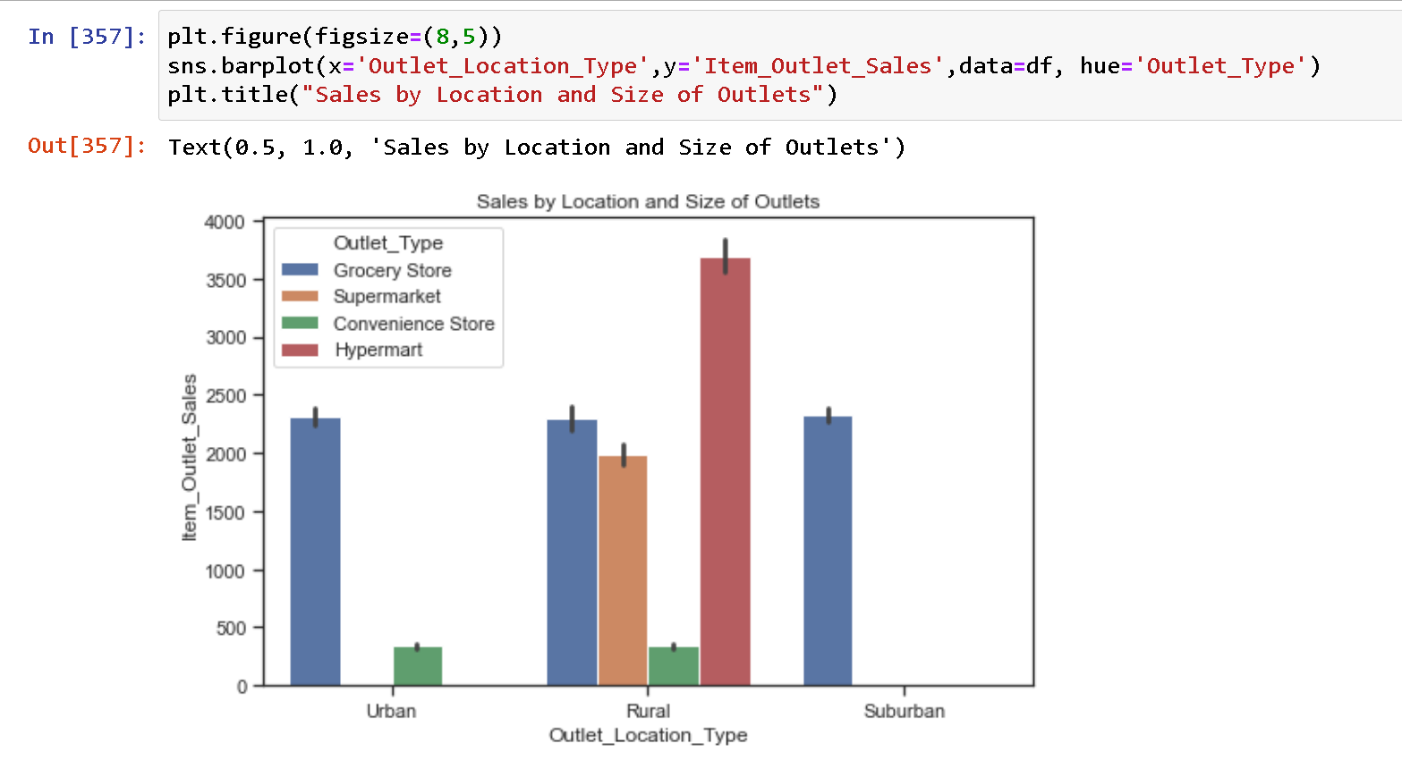

Recommendations by Comparison with Historical Sales Data
Bivariate Analysis of Historical Data
The outlet types in the rural locations are consistent with historical data on outlet sales ; there are most number of Hypermarts in Rural locations as hypermarts generate the most sales

Slide 26
THANK YOU

